Slide 1
Using the Gordon Growth Model to Predict Future Electric Car Company Stock Prices
Alex Khaykin
DATA 604
Final Project

Slide 2
Introduction: Gordon Growth Model can be used to predict future stock prices
The Gordon Growth Model (GGM) is used to calculate the intrinsic value of a company's stock assuming that its shares are worth the sum of all its future dividends after discounting their present value. Although typically used only for mature companies in established markets, here I am using the GGM to attempt to explore how we might expect future stock prices to look for electric car companies Tesla and Rivian once they begin paying shareholder dividends. Note that currently neither company pays shareholder dividends so we can only use anticipated dividends at this stage.
As a single-stage model, the GGM assumes a company’s dividends continue to grow at a constant rate. The GGM is a simple model that only takes a few inputs to predict the company's stock prices.
Flow Chart
A flow chart can be designed to show both the theoretical inputs for the Gordon Growth Model (solid line) as well as the actual inputs used (dashed line).
Theoretical Inputs

Slide 3
There are different formulations of the GGM, but all are attempting to estimate the **future stock price** here denoted as *P*. All formulations derive the take some form of:
Value of next period dividend, here *D<sub>1</sub>*
Minimum rate of return or the company's cost of equity capital, *r*
Constant dividend growth rate, *g*
Actual Inputs
Note that because neither of the electric car companies, Tesla or Rivian, are currently paying dividends to shareholders, we are using a **consensus anticipated Earnings Per Share (EPS)** to derive the value of D<sub>1</sub>*.
For r, I will use a value estimated using a Capital Asset Pricing Model, which is what is most commonly used.
For g, I will use a trailing twelve-month (TTM) dividend yield that is estimated from the median of the stock sector, here electric vehicles. This means that *g* is the same for both Tesla and Rivian.

Slide 4
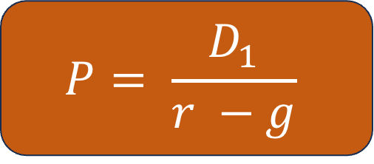
Gordon Growth Model (GGM)
$$P= \frac{D_{1}}{r −g}$$
– Solid line denotes theoretical input
- - Dashed line denotes actual input
D₁ = Value of expected or next fiscal year’s dividend
r = minimum rate of return, or company’s constant cost of equity capital
g = constant growth
rate expected for dividends
NASDAQ Consensus EPS Yearly Earnings Forecast
Cost of Equity estimations using Capital Asset Pricing Model
Trailing Twelve-Month (TTM) Dividend Yield
Notes:
P=Current stock price
g=Constant growth rate expected for dividends, in perpetuity
r=Constant cost of equity capital for the company (or rate of return)
D1​=Value of next year’s dividends​

Slide 5
D₁ | r | g
2.96 (Source: NASDAQ) | 11.6% (Source: Finbox) | 12.66% (Source: Seeking Alpha)
-5.39 (Source: NASDAQ) | 12.4% (Source: Finbox) | 12.66% (Source: Seeking Alpha)
TESLA
RIVIAN

Slide 6
Analysis Plan
My analysis and modeling plan consists of exploring both historic stock price data to look at current trends and then using these data to estimate future stock prices from a mean annual growth rate. From there, I will then use the GGM to simulate how future stock prices might look given that the mean annual growth rate calculated from the data contains no information about future projections for the stock.
1. Exploring historical stock closing price data to look for trends.
2. Using past performance to simulate future stock prices over the next 20 years using the growth trends thus far.
3. Simulating future stock prices over the next 20 years using the Gordon Growth Model.
1. Exploring historical stock closing price data to look for trends.
Before simulating future stock prices with the GGM, I wanted to explore historical stock prices to see if there are similar trends between Tesla and Rivian. Although Tesla has been a publicly-traded company longer than Rivian, we have data for several years now for both companies.

Slide 7
2. Using past performance to simulate future stock prices over the next 20 years using the growth trends thus far.
Constant Growth Rate Calculated from Past Data for Each Company
Using a simple assumption that annual growth rate can be used to predict future growth, I ran a simulation to see what we might expect the companies' stock prices to do over the next 20 years.
Building the Simulation Function
The simulation function uses an average growth in the closing stock prices for each of the companies, Tesla and Rivian. It only takes a single parameter, a dataframe.
Calculates the difference between the ending closing stock price and the beginning closing price
Finds the number of days that have elapsed in the dataset
Calculates a daily growth rate
Converts that daily growth rate to an average annual growth rat
3. Simulating future stock prices over the next 20 years using the Gordon Growth Model.

Slide 8
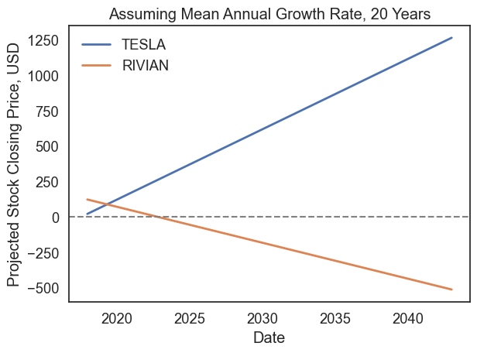
Conclusion: If we assume constant growth trends for each company, then according to their past performance by 2043 Tesla stock would be valued at nearly 1300 USD per share whereas Rivian would become worthless by the end of 2023.
However, the difficulty with constant growth models is that they are oversimplifying and do not consider growth in the sector overall. The Gordon Growth Model does.

Slide 9
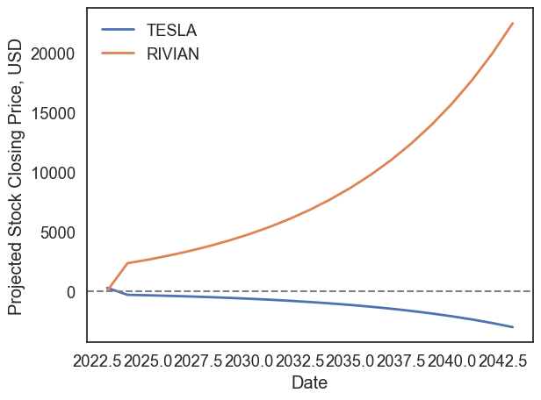

Slide 10
Conclusion
The Gordon Growth Model predicts an opposite trend than using the historical data - Tesla will crash within a year, and Rivian prices will climb nearly exponentially.
The key difference between the constant growth model in Part 2 and the GGM is that the constant growth model only uses historical data to predict future prices. The GGM takes more information into account, including both how the stock itself is predicted to grow as well as how the market sector is expected to grow, and ignores past performance.
Both models are very simplifying, and the assumptions used determine the outputs. A major limitation of the GGM used here is that it assumes that over the 20-year period, both the stock growth rate and the market sector growth rate will remain constant. This is unlikely to occur. Further, because the GGM does not take historical performance into account, it is not accounting for the fact that Tesla stock has continued to rise over the past 5 years despite some dips in prices. It also does not account for the fact that Rivian stock is currently at an all-time low.
Future directions would attempt to model stock prices using a hybrid model that includes both past trends as well as different growth projections for both companies and the electric vehicle sector.

